Slide 1
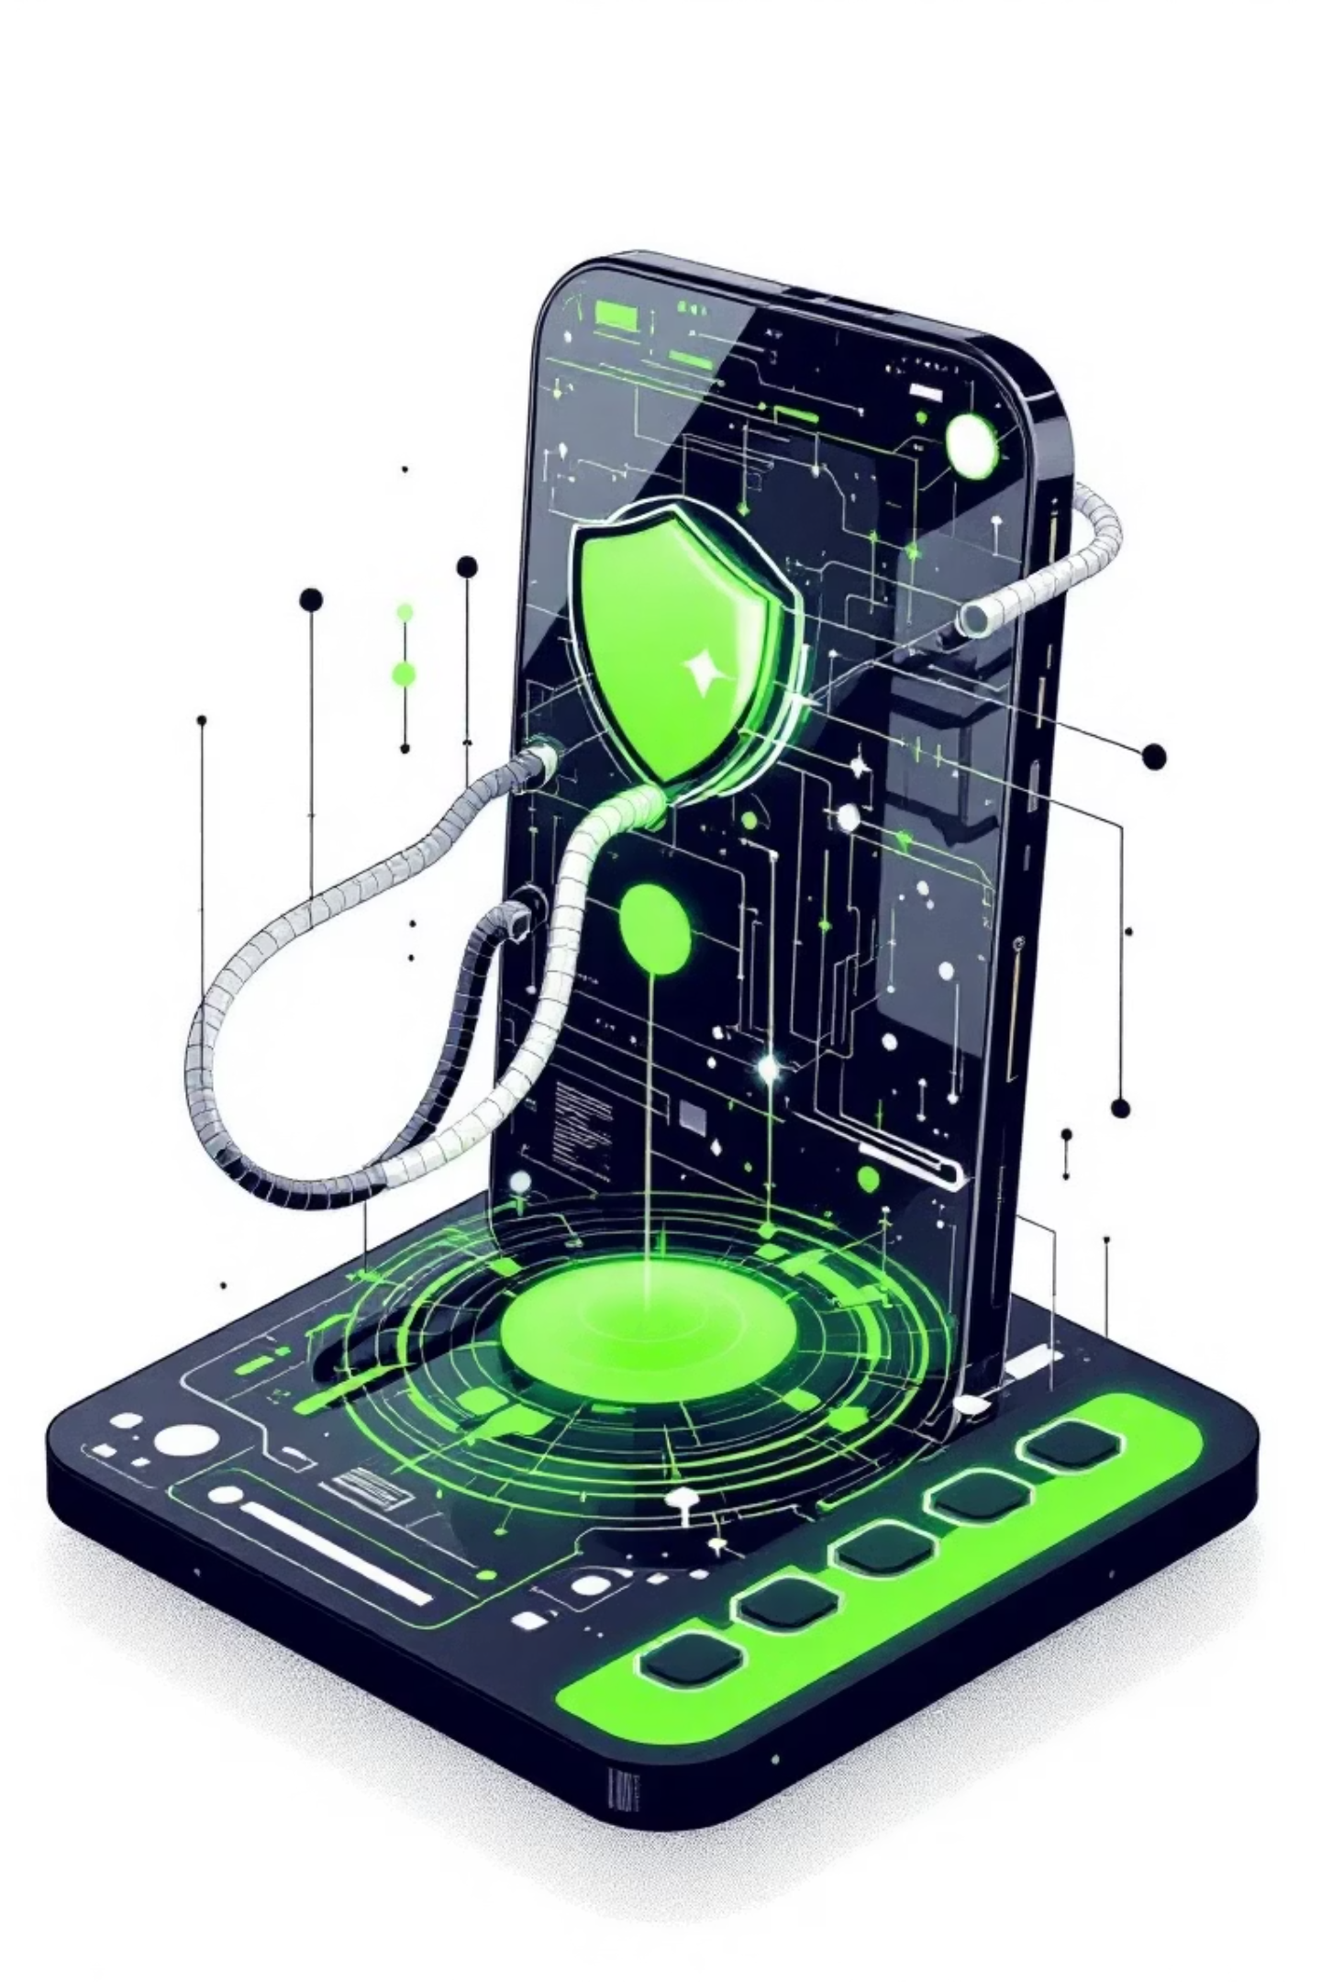
TZ-LLM: Protecting On-Device Large Language Models with Arm TrustZone
Xunjie Wang*, Jiacheng Shi*, Zihan Zhao, Yang Yu, Zhichao Hua, Jinyu Gu
Institute of Parallel and Distributed Systems, School of Computer Science
Shanghai Jiao Tong University

Slide 2
The Challenge: Security vs. Performance
On-Device LLMs: The Promise
The Security Risk
Enhanced user privacy through local processing
Proprietary models exposed to end users
Reduced network latency for faster responses
Vulnerable to curious users or malicious applications
Lower inference costs compared to cloud services
Plaintext parameters in memory during inference
Personal data remains on the device
Millions of dollars in development at risk
While on-device LLMs offer significant advantages, they introduce a critical vulnerability: model parameters stored on personal devices can be compromised through OS exploitation or memory extraction attacks.

Slide 3

Two Fundamental Challenges
Memory Efficiency vs. Fast Inference
Efficient TEE-REE NPU Time-Sharing
Static secure memory allocation wastes resources on resource-constrained mobile devices (≤24GB). Dynamic scaling requires time-consuming contiguous physical memory allocation, file I/O, and decryption—adding up to 11.6s startup overhead for Llama-3-8B.
NPUs can improve LLM performance by up to 7.3×, but REE applications also need NPU access. Existing solutions require porting large driver codebases (60K+ LoC) to TEE, bloating the TCB and incurring 32ms switching overhead per world switch.

Slide 4
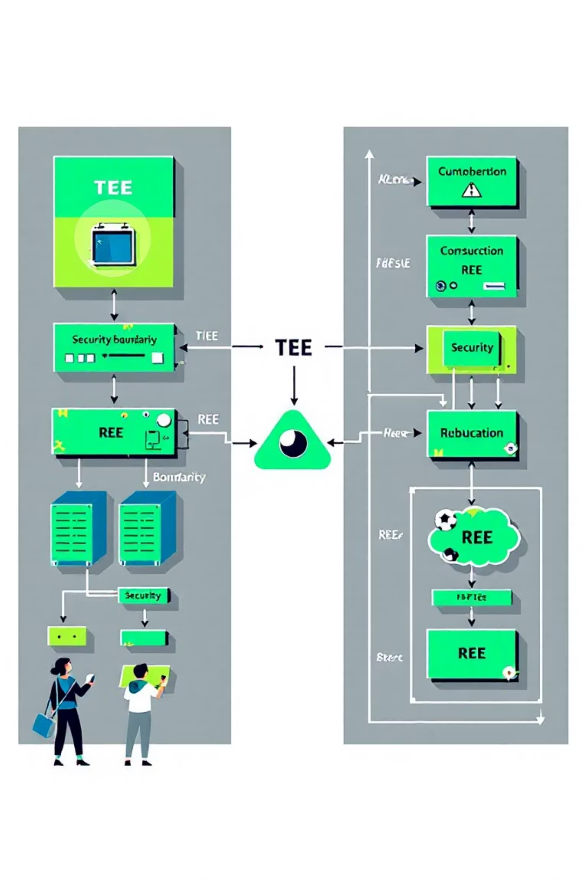
TZ-LLM System Architecture
TZ-LLM runs the LLM inference framework as a Trusted Application (TA) within Arm TrustZone's Trusted Execution Environment. The system leverages hardware isolation to protect model parameters while maintaining efficient communication with the Rich Execution Environment for resource management and acceleration.
01
TEE Execution
LLM inference runs in isolated TEE with protected memory regions
02
Dynamic Scaling
Secure memory extends and shrinks based on inference needs
03
NPU Acceleration
Co-driver design enables secure NPU access from TEE
04
REE Coordination
Untrusted OS handles scheduling and resource allocation

Slide 5
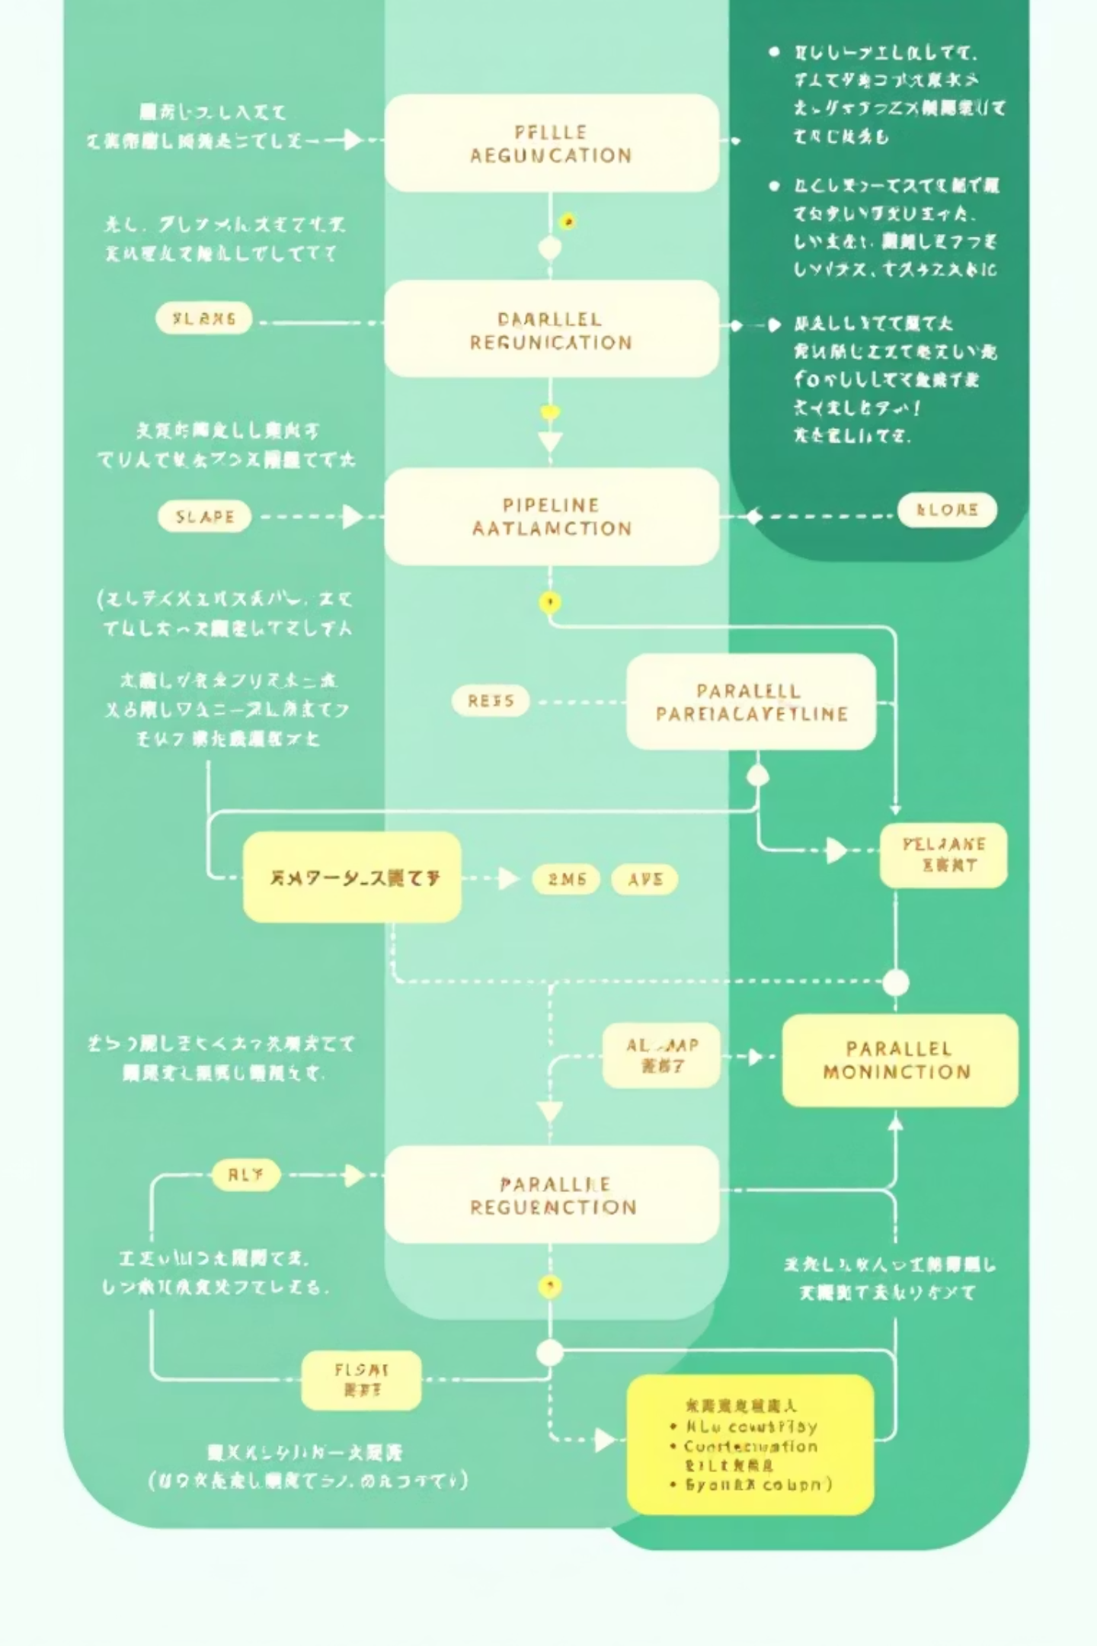



Innovation #1: Pipelined Restoration
Overlapping Operations to Hide Latency
TZ-LLM exploits the deterministic memory access patterns of LLM inference to prefetch parameters on demand. By loading parameters in topological order while executing inference operators in parallel, we hide memory allocation, I/O, and decryption overhead under computation time.
Priority Scheduling
Prioritizes urgent tasks that could stall the critical inference path
Partial Caching
Caches early parameters when memory permits for instant next inference
Preemptive Execution
Divides operations into micro-tasks with preemption points

Slide 6
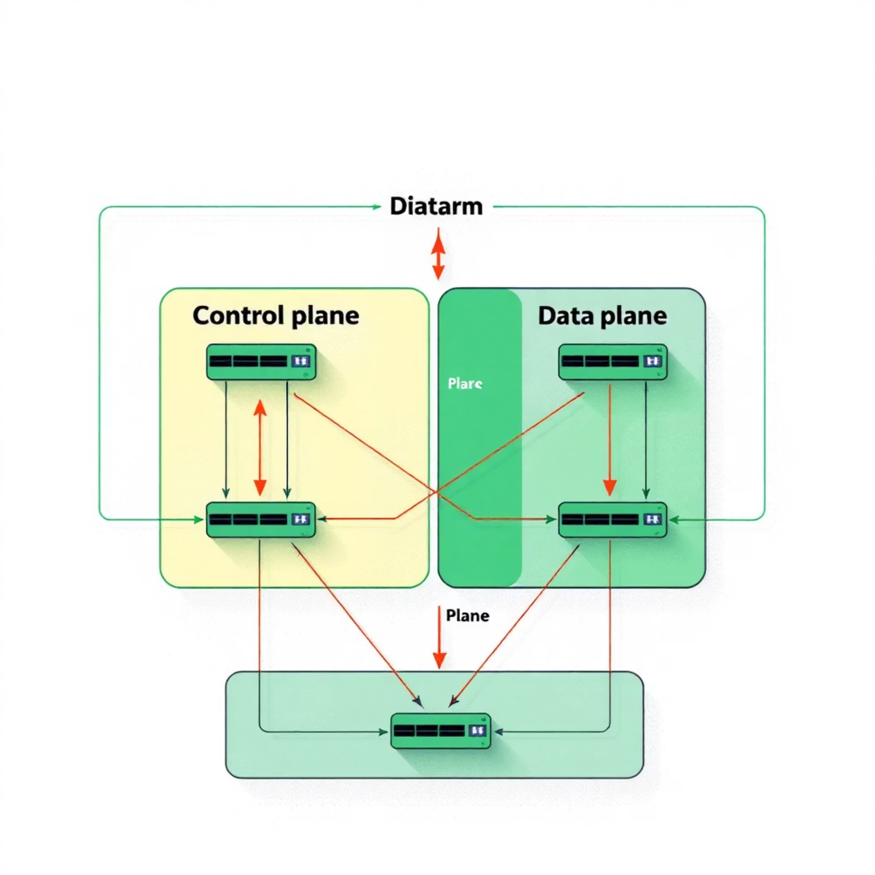
Innovation #2: Co-Driver Design for NPU Time-Sharing
Separating Control and Data Planes
The data plane performs job execution—a minimal, self-contained closure requiring only ~1K LoC in TEE. The control plane handles complex operations like scheduling and power management, remaining in the REE where it belongs.
This separation enables NPU world switches without control plane reinitialization while minimizing the TCB in TEE.
Isolated Execution Environment
Minimal TCB Extension
Unified Scheduling
TEE driver switches NPU between secure and non-secure modes, protecting MMIO regions and routing interrupts appropriately
User-mode NPU driver in TEE is confined to NPU MMIO region access only, with TZASC limiting DMA to specific regions
REE driver maintains single queue for secure and non-secure jobs, delegating secure job execution to TEE driver

Slide 7

Performance Results: Time-to-First-Token
76-91%
5-28%
12.5×
TTFT Reduction
Overhead vs. REE
NPU Speedup
Compared to strawman TEE baseline across all models and benchmarks
Performance penalty compared to unprotected REE baseline with flash loading
Rockchip NPU acceleration for Llama-3-8B prefill stage
TZ-LLM achieves dramatic reductions in startup time through pipelined restoration, NPU support, and checkpoint/restoration mechanisms. The system successfully hides parameter loading overhead under computation time, particularly for medium and long prompts.

Slide 8
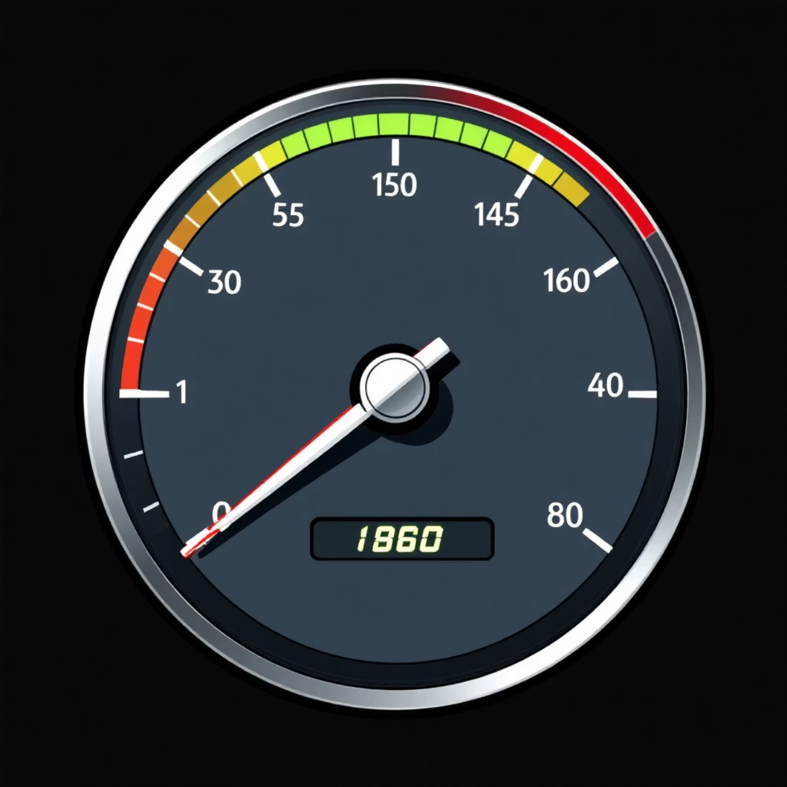
Performance Results: Decoding Speed
Token Generation Performance
During the decoding phase, TZ-LLM demonstrates consistent performance improvements over the strawman baseline while maintaining minimal overhead compared to the REE baseline.
0.9-23.2% improvement over strawman baseline with NPU support
1.3-4.9% slowdown compared to REE baseline due to driver communication
Overhead decreases for larger models due to longer NPU computation time
The modest gains compared to prefill stage reflect the single-batch computation pattern of decoding, which cannot fully utilize NPU computation power. However, the security guarantees come with acceptable performance trade-offs.

Slide 9
Security Guarantees
Direct Access Protection
DMA Attack Prevention
TZASC hardware blocks REE attempts to access plaintext parameters in secure memory. Model files encrypted with hardware-protected TEE keys.
TZPC isolates NPU MMIO interface. TZASC rejects untrusted device access. TEE driver validates all NPU jobs before execution.
Iago Attack Mitigation
Minimal System Impact
Validates memory address contiguity, NPU job authorization, model loading checksums, and thread synchronization primitives.
Only ~100 LoC modifications to privileged TEE OS. User-mode NPU driver with strict address space isolation from other TAs.

Slide 10

Conclusion: Practical TEE-Based LLM Protection
Key Contributions
Real-World Impact
First system to efficiently protect on-device LLMs using Arm TrustZone
Evaluated on Orange Pi with Rockchip RK3588
Pipelined restoration mechanism for elastic secure memory scaling
Tested with production models: TinyLlama, Qwen2.5, Phi-3, Llama-3
Co-driver design for efficient TEE-REE NPU time-sharing
Minimal TCB extension (~100 LoC privileged code)
Practical implementation on OpenHarmony with llama.cpp
Balances security, performance, and memory efficiency
TZ-LLM demonstrates that strong security guarantees for on-device LLMs are achievable with acceptable performance trade-offs. By addressing the fundamental challenges of secure memory scaling and accelerator access, the system opens new possibilities for deploying proprietary models on mobile devices while protecting intellectual property.

